Slide 1
Discrete-time analysis of a 4-way-crossing in conveying systems under the dispatching policy round robin
SMMSO 2015
Rimmele, Furmans and Epp

Slide 2
Outline
Introduction
System description
Discrete-time analysis
  Iterative algorithm
  Cycle time distribution
  Steady-state probabilities
  Service time distribution
  Waiting time distribution
  Interdeparture time distribution
Numerical Study
Conclusion and future work

Slide 3
Introduction
A 4-way crossing in conveying systems

Slide 4
Introduction
The dispatching policy round robin
conveying units
no. | source | drain
1 | 1 | 1
2 | 1 | 2
3 | 2 | 2
4 | 1 | 1
5 | 2 | 1

Slide 5
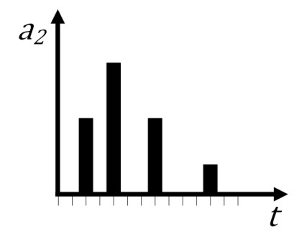
System description
conveying time distribution of queue 1
INPUT
interarrival time distribution of queue 1
interarrival time distribution of queue 2
conveying time distribution of queue 2
Tran-Gia (1992)

Slide 6
System description
OUTPUT
waiting time distribution of queue 1
interdeparture time distribution of drain 1
waiting time distribution of queue 2
interdeparture time distribution of drain 2
Tran-Gia (1992)

Slide 7
Discrete-time analysis
Iterative algorithm
Initialization
Calculate the cycle time distribution
Calculate the steady-state probabilities
Repeat steps 2-3 until a convergence criterion for the steady-state is fulfilled
Calculate the service time distribution
Repeat steps 2-5 until convergence criterion for the service time is fulfilled
Calculate the waiting time distribution and the inter departure time distribution

Slide 8
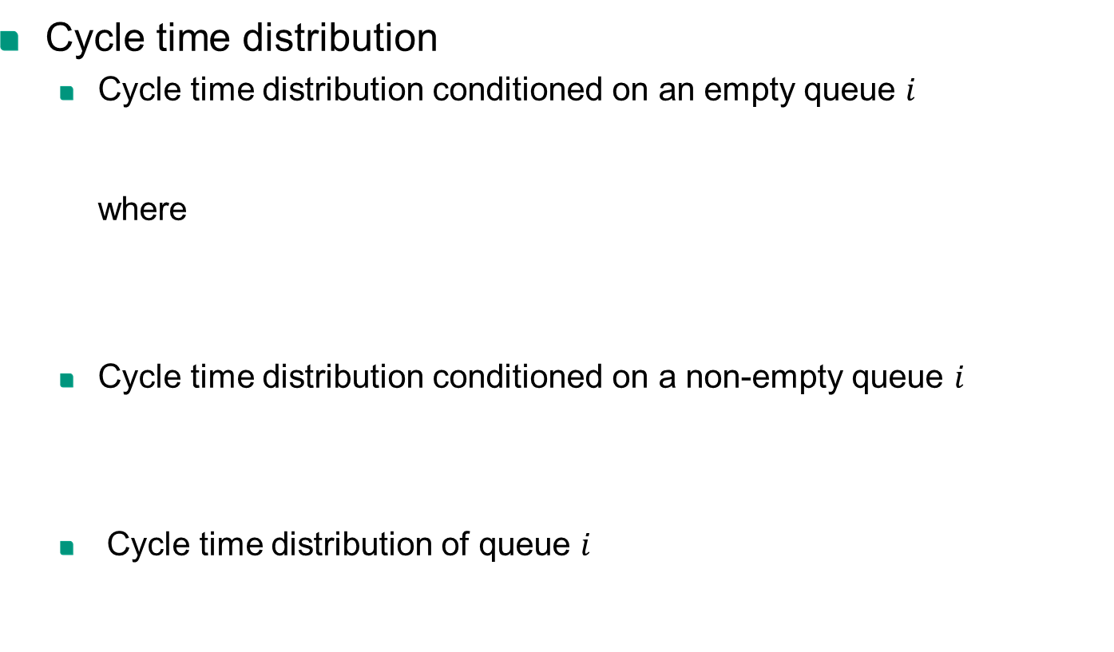
Discrete-time analysis
Cycle time distribution
  Cycle time distribution conditioned on an empty queue $i$
  where
  Cycle time distribution conditioned on a non-empty queue $i$
  Cycle time distribution of queue $i$

Slide 9
Discrete-time analysis
Steady-state probabilities
  Distribution of the arrival time of the ℎ-th customer
  Group size distribution
  Steady state

Slide 10
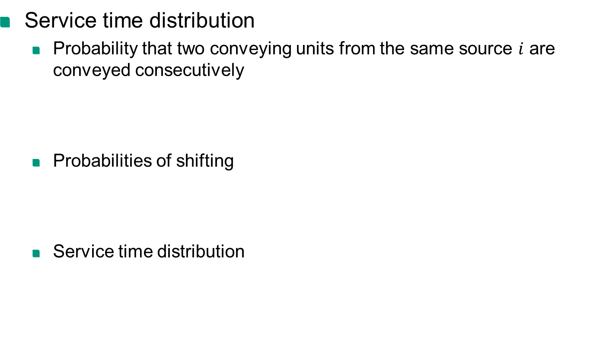
Discrete-time analysis
Service time distribution
  Probability that two conveying units from the same source $i$ are conveyed consecutively
  Probabilities of shifting
  Service time distribution

Slide 11




















Discrete-time analysis
Waiting time distribution
  Conditional waiting time distribution of the first customer
$$\hat{x}=0, 1$$
$$\hat{x}>1$$
$$0$$
$$…$$
$$\hat{x}−1$$
$$1$$
$$2$$
$$…$$
$$l$$
$$1$$
$$2$$
$$…$$
$$l$$
$$1$$
$$1$$
$$\hat{c}$$
$$\hat{c}$$
$$\hat{w}−\hat{c}+y$$
$$\hat{c}−\hat{w}$$
$$\hat{w}$$
$$y$$
$$\hat{w}$$
$$\hat{x}$$
$$\hat{x}$$

Slide 12























Discrete-time analysis
Waiting time distribution
  Conditional waiting time distribution of the $l$-th customer
$$\hat{x}=0, 1$$
$$\hat{x}>1$$
$$0$$
$$…$$
$$l−1$$
$$0$$
$$…$$
$\hat{x}+l−$2
$$1$$
$$2$$
$$…$$
$$l$$
$$1$$
$$2$$
$$…$$
$$l$$
$$l$$
$$l$$
$$\hat{c}$$
$$\hat{w}−\hat{c}+y+z$$
$$\hat{c}$$
$$\hat{w}−\hat{c}+y+z$$
$$y$$
$$z$$
$$\hat{w}$$
$$y$$
$$z$$
$$\hat{w}$$
$$\hat{x}$$
$$\hat{x}$$

Slide 13
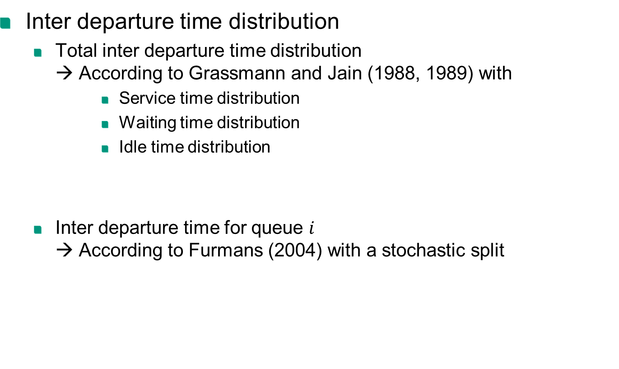
Discrete-time analysis
Inter departure time distribution
  Total inter departure time distribution
  → According to Grassmann and Jain (1988, 1989) with
      Service time distribution
      Waiting time distribution
      Idle time distribution
  Inter departure time for queue $i$
  → According to Furmans (2004) with a stochastic split

Slide 14
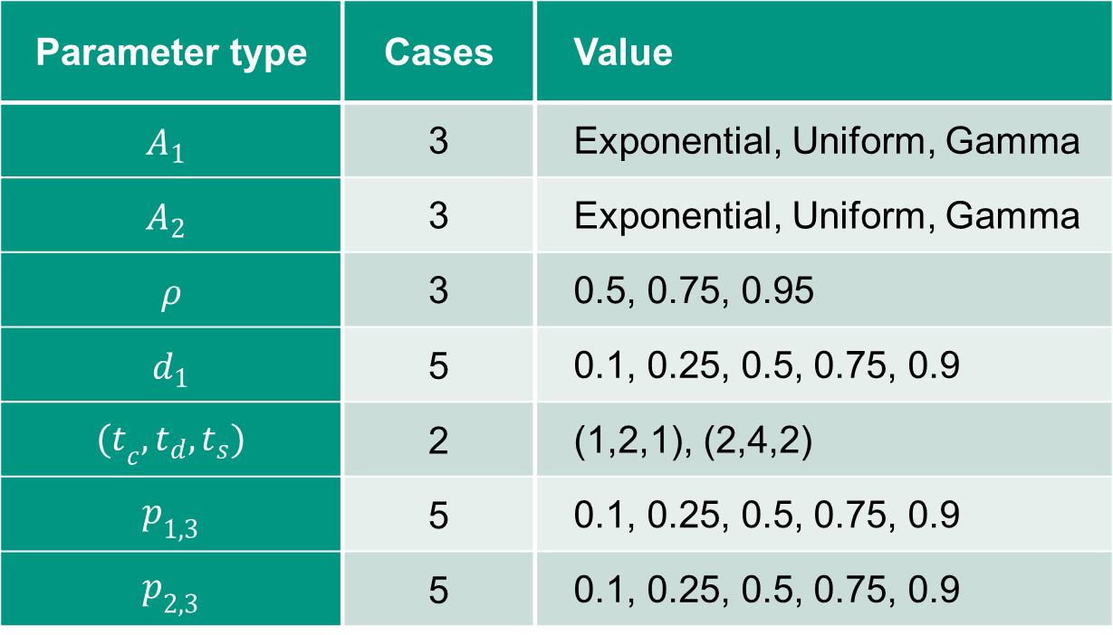
Numerical study
Parameter settings
Parameter type | Cases | Value
$$A_{1}$$ | 3 | Exponential, Uniform, Gamma
$$A_{2}$$ | 3 | Exponential, Uniform, Gamma
$ρ$ | 3 | 0.5, 0.75, 0.95
$d_{1}$ | 5 | 0.1, 0.25, 0.5, 0.75, 0.9
${(t}_{c},t_{d},t_{s})$ | 2 | (1,2,1), (2,4,2)
$p_{1,3}$ | 5 | 0.1, 0.25, 0.5, 0.75, 0.9
$p_{2,3}$ | 5 | 0.1, 0.25, 0.5, 0.75, 0.9

Slide 15
Numerical study
Distribution of the relative and absolute errors for the waiting time of source 1

Slide 16
Numerical study
Distribution of the relative and absolute errors for the inter departure time of drain 1

Slide 17
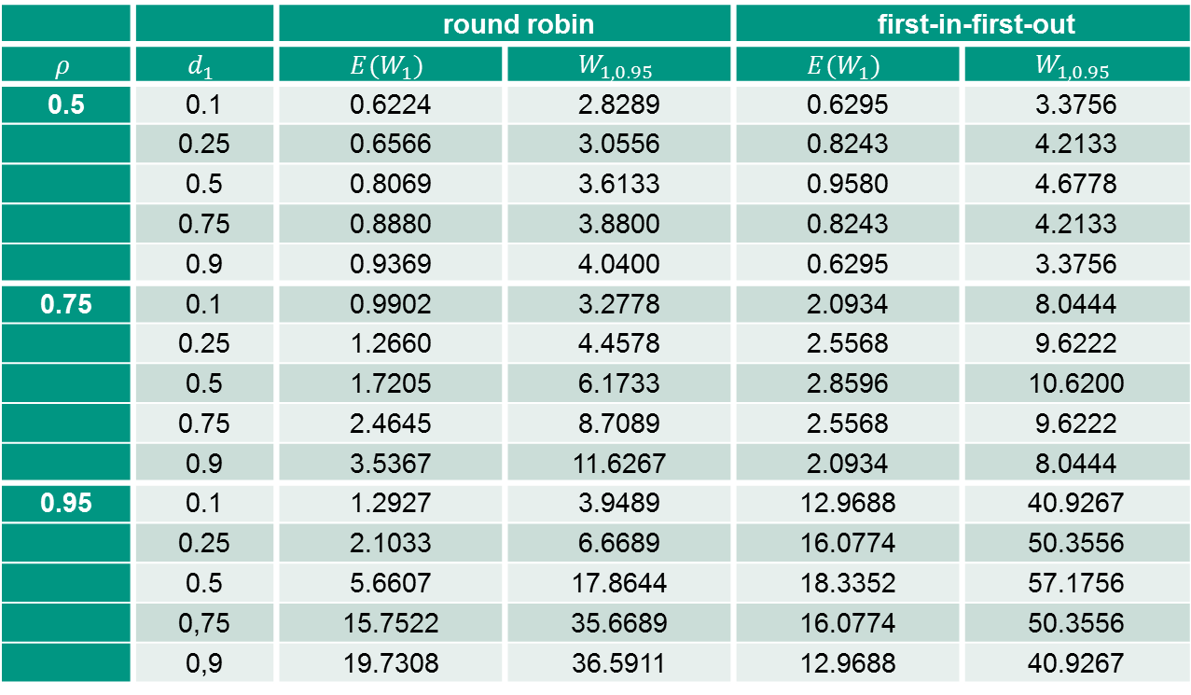
Numerical study
Comparison of round robin and first-in first-out
 |  | round robin |  | first-in-first-out
$$ρ$$ | $$d_{1}$$ | $$E(W_{1})$$ | $$W_{1,0.95}$$ | $$E(W_{1})$$ | $$W_{1,0.95}$$
0.5 | 0.1 | 0.6224 | 2.8289 | 0.6295 | 3.3756
 | 0.25 | 0.6566 | 3.0556 | 0.8243 | 4.2133
 | 0.5 | 0.8069 | 3.6133 | 0.9580 | 4.6778
 | 0.75 | 0.8880 | 3.8800 | 0.8243 | 4.2133
 | 0.9 | 0.9369 | 4.0400 | 0.6295 | 3.3756
0.75 | 0.1 | 0.9902 | 3.2778 | 2.0934 | 8.0444
 | 0.25 | 1.2660 | 4.4578 | 2.5568 | 9.6222
 | 0.5 | 1.7205 | 6.1733 | 2.8596 | 10.6200
 | 0.75 | 2.4645 | 8.7089 | 2.5568 | 9.6222
 | 0.9 | 3.5367 | 11.6267 | 2.0934 | 8.0444
0.95 | 0.1 | 1.2927 | 3.9489 | 12.9688 | 40.9267
 | 0.25 | 2.1033 | 6.6689 | 16.0774 | 50.3556
 | 0.5 | 5.6607 | 17.8644 | 18.3352 | 57.1756
 | 0,75 | 15.7522 | 35.6689 | 16.0774 | 50.3556
 | 0,9 | 19.7308 | 36.5911 | 12.9688 | 40.9267

Slide 18
Conclusion and future work
We developed a model of a 4-way-crossing based on a polling system, in which a single server serves two queues cyclically.
Future work will be dedicated to model further dispatching policies (e.g. exhaustive) based on this approach.
A comparison of different dispatching policies should be considered in more detail.

Slide 19
Thank you for your attention!

Slide 20

Karlsruhe Institute for Technology (KIT)
Institute for Material Handling and Logistics (IFL)
Postal address Kaiserstr. 12
DE-76128 Karlsruhe
Visitor address Gotthard-Franz-Str. 8, Geb. 50.38
DE-76131 Karlsruhe
Phone +49-721-608-48600
Fax +49-721-608-48629
Email info@ifl.kit.edu
www http://www.ifl.kit.edu

Slide 21
References
Boxma, J. 1984. Two symmetric queues with alternating service and switching times. Proc. Perf. 409-431.
Furmans, K. 2004. A framework of stochastic finite elements for models of material handling systems. Progress in material handling research: 8. International Material Handling Research Colloquium.
Grassmann, W.K., J.L. Jain. 1988. Numerical solution for the departure process from the GI/G/1 queue. Comput. Opns Res. 15 (3) 293-296.
Grassmann, W.K., J.L. Jain. 1989. Numerical solutions of the waiting time distribution and idle time distribution of the arithmetic GI/G/1 queue. Operations Research 37 (1) 141-150.
Kuehn, J. 1979. Multiqueue systems with nonexhaustive cyclic service. Bell Sysi. Tech. J. 58 671-699.
Manfield, D. R. 1983. Analysis of a polling system with priorities. Proc. GLOBECOM 43 (4).
Matzka, J. 2011. Discrete time analysis of multi-server queueing systems in material handling and service. PhD Thesis. Karlsruhe Institute of Technology
Özden, E. 2011. Discrete time Analysis of Consolidated Transport Processes. PhD Thesis. Karlsruhe Institute of Technology
Schleyer, M. 2007. Discrete time analysis of batch processes in material flow systems. Ph.D. thesis, Institut für Fördertechnik und Logistiksysteme (IFL), University Karlsruhe.
Schleyer, M., K. Furmans. 2007. An analytical method for the calculation of the waiting time distribution of a discrete time G/G/1-queueing system with batch arrivals. OR Spectrum 29 (4) 745-763.
Takagi H. 1986. Analysis of Polling Systems. MIT Press
Tran-Gia, P. 1992. Analysis of polling systems with general input process and finite capacity. IEEE 'Transactions on Communications 40 (2).
Tran-Gia P., T. Raith. 1985. Multiqueue systems with finite capacity and nonexhaustive cyclic service. Proc. Int. Sem. Comput. Networking Perform. Eval. .

